Slide 1


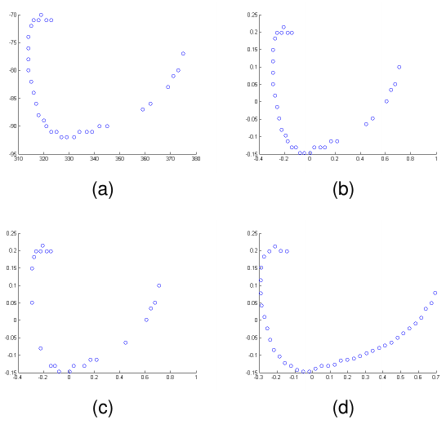
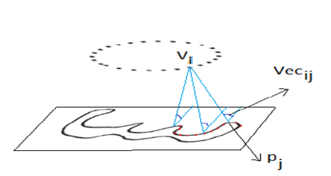
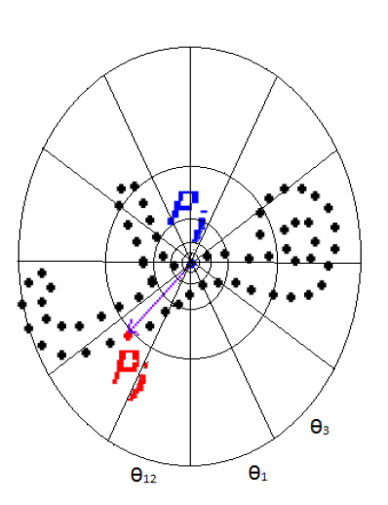
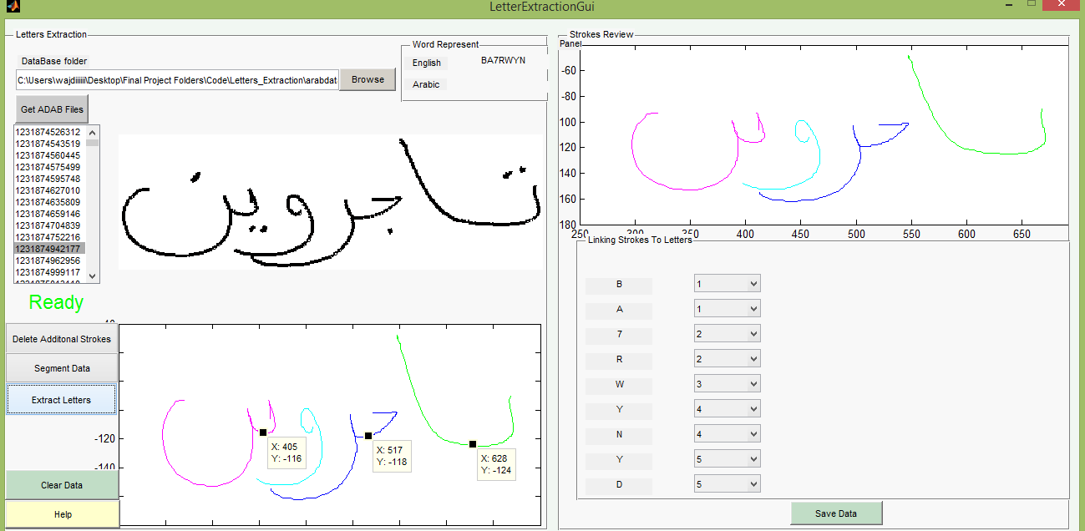
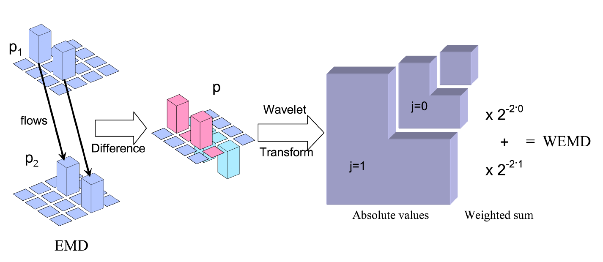
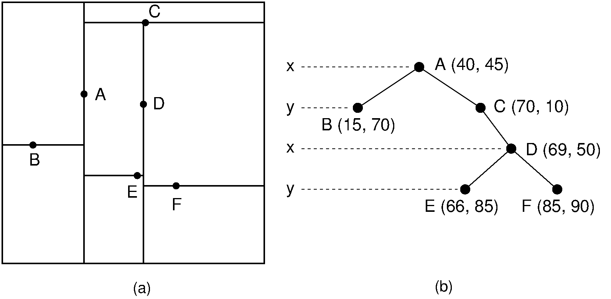
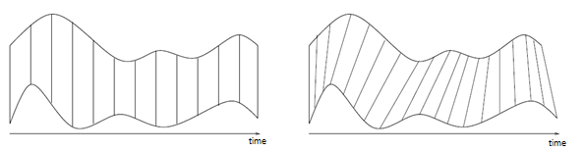


Fast classification of handwritten on-line Arabic characters
George Kour and Raid Saabni‡
† Faculty of Engineering, Tel-Aviv University
‡ Triangle R&D Center, Kafr Qara, Israel
Introduction
The classifier
Experimental Results
Delaying the analysis launch until the completion of the handwritten word scribing:
Restricts highly responsiveness demands.
Prevents implementing advanced features of input typing, such as Automatic word completion & Real-time automatic spelling.
We proposes an efficient Arabic handwritten characters recognizer aimed at facilitating real-time handwritten script analysis tasks.
Letter Position | Accuracy | Recall | Precision
Ini | 93% | 85% | 88%
Mid | 89% | 87% | 90%
Fin | 91% | 86% | 92%
Iso | 91% | 81% | 90%
Overall | 91% | 85% | 90%
Preprocessing
(a) (b)
Multi Angular Descriptor (MAD)
Shape Context Descriptor (SC)
Sample set
Feature Extraction
The system was trained and tested on characters and word parts extracted from the ADAB database.
We are planning to standardize and publish the characters database extracted from the ADAB database and make available for other researches in the field.
Shape Descriptor | Accuracy [Top 1] | Accuracy [Top 3]
SC | 91% | 96%
MAD | 88% | 94%
None | 87% | 93%
Manual Segmentation
EMD Embedding
Dimensionality Reduction
Activation Configurations
EMD computation complexity is its $O(N^{3}logN)$ for an $N$-bin histogram. Greatly reducing the EMD calculation time can be achieved using metric approximation techniques.
$${d(p)}_{wemd}=\sum_{λ}{2^{−j(1+n/2)}\left|p_{λ}\right|}$$
The embedding of the sample set into a normed space facilitates the usage of metric indexing methods to solve the problem of searching k-NN in a large set and avoid linear scan of the entire dataset.
The embedding is done using Shirdhonkar and Jacobs’ method.
The Haar wavelet achieved the best classification results.
Since there is a large variation in handwritten letters in the Arabic script, the grouping different perceptual shapes in a single class would negatively affect the LDA.
Thus, before applying LDA, each character class was partitioned into four clusters, using $L_{1}−k medoids$ algorithm, and for each cluster a unique sub-label was assigned.
The target number of dimensions was estimated using the maximum likelihood estimation method.
High Accuracy: The Proposed Approach
Low Latency: Avoid Candidates Rescoring
Fast Learning: Avoid DR and metric indexing
Configuration | Accuracy [Top 1] | Accuracy [Top 3] | Time [ms]
High Accuracy | 91% | 96% | 29.9
Low Latency | 87% | 94% | 0.12
Fast Learning | 90% | 96% | 4.4
# of Samples | Letter Position
1405 | Ini
1196 | Mid
1629 | Fin
1372 | Iso
Dimensionality Reduction
The dimensionality of the four datasets after applying PCA and PCA+LDA.
Candidates Rescoring
PCA+LDA | PCA | Letter Position
9 | 48 | Ini
10 | 52 | Mid
9 | 44 | Fin
8 | 39 | Iso
K-d tree Indexing
Use DTW to rescore candidates using the original sequence.

